Slide 1
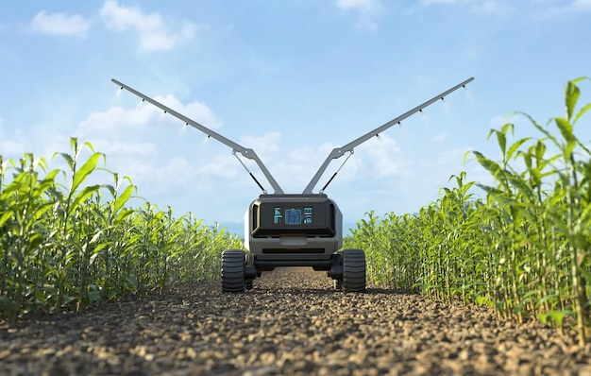
FERTILIZER SPRAYING ROBOT

Slide 2
Group 15
Members
GAHDSE241F-044 Ranasingha A.S GAHDSE241F-045 C.D.Wijesekara
GAHDSE241F-046 J.K.N.T.Dilshan

Slide 3
Introduction
Problem Statement
Literature Review
Proposed solution
Methodology Expected Results
Content

Slide 4
INTRODUCTION
The Fertilizer Robot is an Arduino smart device built to simplify the application of fertilizers to plants in the agricultural field.
Crop yield can be increased
Able to reduce human labor costs and environmental impact
Our robots recognize the plants and move along the rows to spray the fertilizer.
The aim of this system is to reduce fertilizer wastage.
The Arduino Broad acts as the brain of the robot.
This project is important to improve agricultural practices
Main objective –The objective of our project is to develop an autonomous robot that can detect plants and spray fertilizer accurately using IR sensors.
What is the problem it seeks to solve – Increasing the efficiency of fertilizer application in agriculture, reducing labor costs and reducing fertilizer wastage.

Slide 5
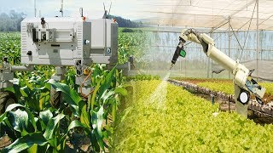
Identify the problem –
The problem here is that human labor is not enough and some fertilizers are not good for the human body. Applying too much fertilizer can damage plants
Importance –
By solving this problem, robots can apply fertilizers without human labor and monitor the condition of the soil, thereby preventing waste of fertilizers and human labor.
Problem statement

Slide 6
Literature Reviews
Reviews of Existing Solution –
Currently, there are many line follow concept.
The plant should be identified and sprayed with fertilizer.
What has been discovered so far is watering the plant
Gap Identification –
The robot should return to the starting position after the amount of fertilizer is exhausted or the fertilizer is finished
We are making this using line following concept and watering plant concept

Slide 7
Proposed solution
The aim of this proposed system is to design a cost effective
Line follow mechanism for navigation
Plant detection using sensors.
Fertilizer Spraying using motors.

Slide 8
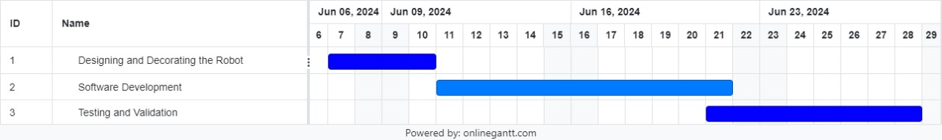
Methodology
Implementation Plan
Step 1: Designing and Decorating the Robot (3 Days)
Put all the components together and finish creating the complete robot.
Step 2: Software Development (10 Days)
Run this robot by writing and adding the code to the Arduino board.
Step 3: Testing and Validation (7 Days)
Test the code to see if the robot is working correctly and correct any errors.
Resources - Software development tools and programming languages

Slide 9
EXPECTED RESULT
Auto-navigation: Having auto-navigation capabilities that enable the robot to move accurately through the farm, avoiding obstacles.
When fertilizer is not enough - Returning the robot to the starting position when the amount of liquid fertilizer placed in the robot is not enough
Plant detection - Plant detection by IR sensor
Fertilizer - Spray each plant with fertilizer

Slide 10
DESIGN

Slide 11
Q & A

Slide 12
Thank You

